Slide 1
Course Outline
Class Number | Topics Covered
9.3 | Introduction + Interactive Exploration System
9.10 | Project Introduction + Research Tips
9.17 | Visual Analytics
9.24 | Data Management
10.8 | Data Mining（确定paper presentation题目: CCF A/B MM SIGIR SIGGRAPH CVPR CHI VIS WWW AAAI KDD. When you are ready, present to me and your teammate before the formal presentation）
10.15 | Advanced Visualization
10.22 | Human-Computer Interaction
10.29 | Perception and Cognition, System Evaluation
11.5 | Project Progress Presentation
11.12-12.3 | Student Paper Presentation (teammate参与点评，总结相比预演练时的进步)
12.10 | Scientific Paper Writing
12.17-12.24 | Final Project Presentation

Slide 2

Data
Practices on Big Data Analytics
Qiong Zeng (曾琼) Yunhai Wang (汪云海)
qiong.zn@sdu.edu.cn cloudseawang@gmail.com

Slide 3
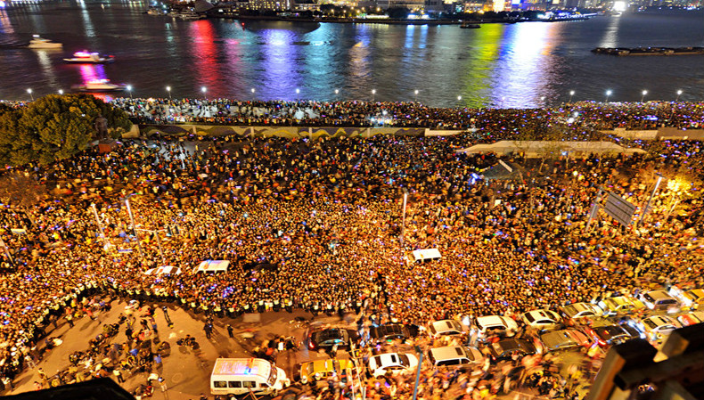
人群在相对狭小区域内的大量聚集
对聚集人群数量及现场应急预防准备不足
陈毅广场存在人流对冲点
事发后应急疏散及救援困难
2014年12月31日，上海外滩的陈毅广场发生一起严重的拥挤踩踏事件，造成36人死亡、49人受伤的严重群死群伤后果。
Notes:
8 到9 点时已经达到了12 万人次，9 点至10 点达16 万人次，10 点到11 点时暴增8 万达到了24 万人次，过了11 点之后，已经突破30 万人次，达到外滩风
景区的容量上限。

Slide 4
监控图像
卫星图像
行人轨迹
Urban computing
What is data?
How to preprocess data?
How to measure data similarity?
地铁流量
出租车轨迹
交通卡口
……
Notes:
一带一路：丝绸之路经济带，21世纪海上丝绸之路 南海 印度洋 欧洲，

Slide 5
学习目标
了解数据及其属性的类型
懂得原始数据预处理的一般方法
熟练运用数据相似性度量邻近度

Slide 6
Outline
Data: attributes and objects
Types of Data
Data Quality
Data Preprocessing
Similarity and Distance

Slide 7
What is Data?
Collection of data objects and their attributes
An attribute is a property or characteristic of an object
Examples: eye color of a person, temperature, etc.
Attribute is also known as variable, field, characteristic, dimension, or feature
A collection of attributes describe an object
Object is also known as record, point, case, sample, entity, or instance
Attributes
Objects

Slide 8
Attribute Values
Attribute values are numbers or symbols assigned to an attribute for a particular object
Distinction between attributes and attribute values
Same attribute can be mapped to different attribute values
Example: height can be measured in feet or meters
Different attributes can be mapped to the same set of values
Example: Attribute values for ID and age are integers
But properties of attribute values can be different

Slide 9
Measurement of Length
The way you measure an attribute may not match the attributes properties.
This scale preserves only the ordering property of length.
This scale preserves the ordering and additvity properties of length.

Slide 10
Types of Attributes
There are different types of attributes
Nominal（标称）
A type of data that is used to label variables without providing any quantitative value
Ordinal（序数）
A categorical, statistical data type where the variables have natural, ordered categories and the distances between the categories is not known
Interval（区间）
Measured along a scale, in which each point is placed at equal distance from one another
Ratio（比率）
A quantitative data, having the same properties as interval data, with an equal and definitive ratio between each data and absolute “zero”
Notes:
Nominal：a type of data that is used to label variables without providing any quantitative value
Ordinal： Ordinal data is a categorical, statistical data type where the variables have natural, ordered categories and the distances between the categories is not known
Interval: is measured along a scale, in which each point is placed at equal distance from one another.
Ratio Data is defined as a quantitative data, having the same properties as interval data, with an equal and definitive ratio between each data and absolute “zero”

Slide 11
Types of Attribute Values
The type of an attribute depends on which of the following properties/operations it possesses:
Distinctness: = ≠
Order: < >
Differences are + - meaningful :
Ratios are * / meaningful
Nominal attribute: distinctness
Ordinal attribute: distinctness & order
Interval attribute: distinctness, order & meaningful differences
Ratio attribute: all 4 properties/operations

Slide 12
Difference Between Ratio & Interval
Height above Average
Height
Notes:
将其改为在1标准大气压下，水的沸点定为100度，冰水混合物的温度定为0度，其间分成100等分，1等分为1度

Slide 13
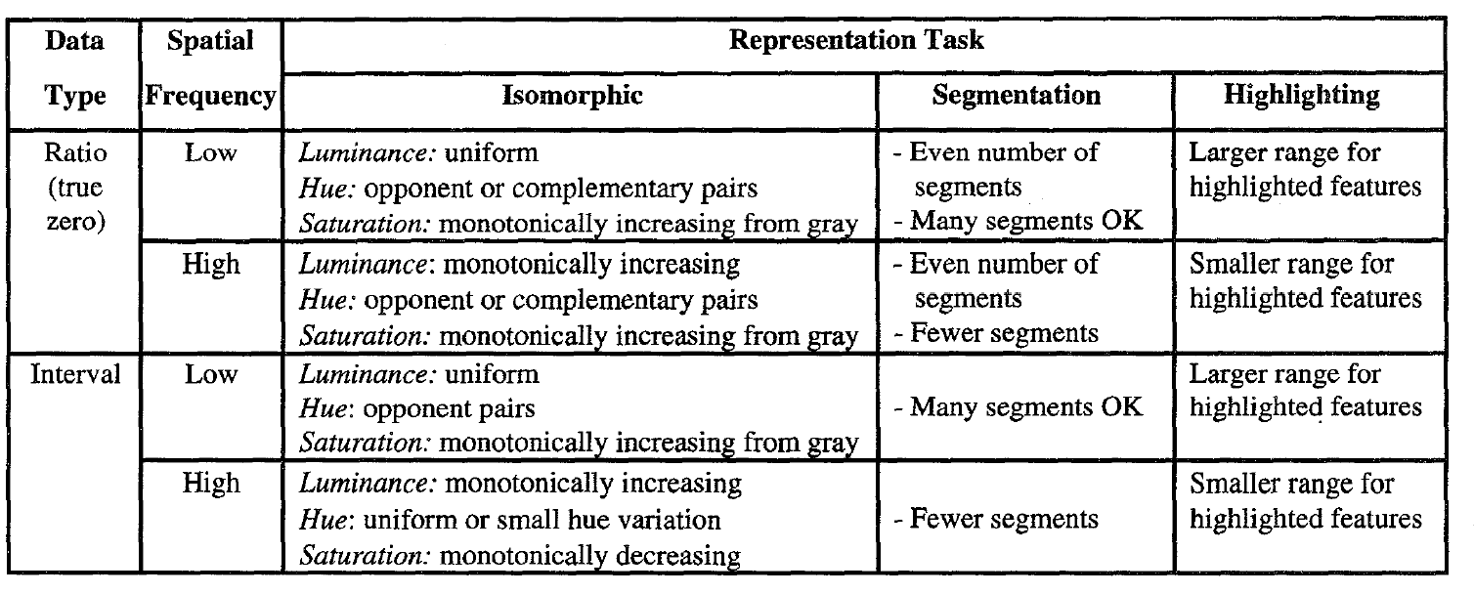
A rule based tool for assisting colormap selection. Lawrence D. Bergman, Bernice E. Rgowitz, Lloyd A. Treinish.

Slide 14
Outline
Data: attributes and objects
Types of Data
Data Quality
Data Preprocessing
Similarity and Distance

Slide 15
Types of Data Sets
Record
Data Matrix
Document Data
Transaction Data
Graph
World Wide Web
Molecular Structures
Ordered
Spatial Data
Temporal Data
Sequential Data
Genetic Sequence Data

Slide 16
Characteristics of Data
Dimensionality (number of attributes)
High dimensional data brings a number of challenges
Sparsity
Only presence counts
Resolution
Patterns depend on the scale
Size
Type of analysis may depend on size of data

Slide 17
Record Data
Data that consists of a collection of records, each of which consists of a fixed set of attributes

Slide 18
Data Matrix
If data objects have the same fixed set of numeric attributes, then the data objects can be thought of as points in a multi-dimensional space, where each dimension represents a distinct attribute
Such data set can be represented by an m by n matrix, where there are m rows, one for each object, and n columns, one for each attribute

Slide 19
Document Data
Each document becomes a ‘term’ vector
Each term is a component (attribute) of the vector
The value of each component is the number of times the corresponding term occurs in the document.

Slide 20
Transaction Data
A special type of record data, where
Each record (transaction) involves a set of items.
For example, consider a grocery store. The set of products purchased by a customer during one shopping trip constitute a transaction, while the individual products that were purchased are the items.

Slide 21
Graph Data
Examples: Generic graph, a molecule, and webpages
Benzene Molecule: C6H6

Slide 22
Ordered Data
Genomic sequence data

Slide 23
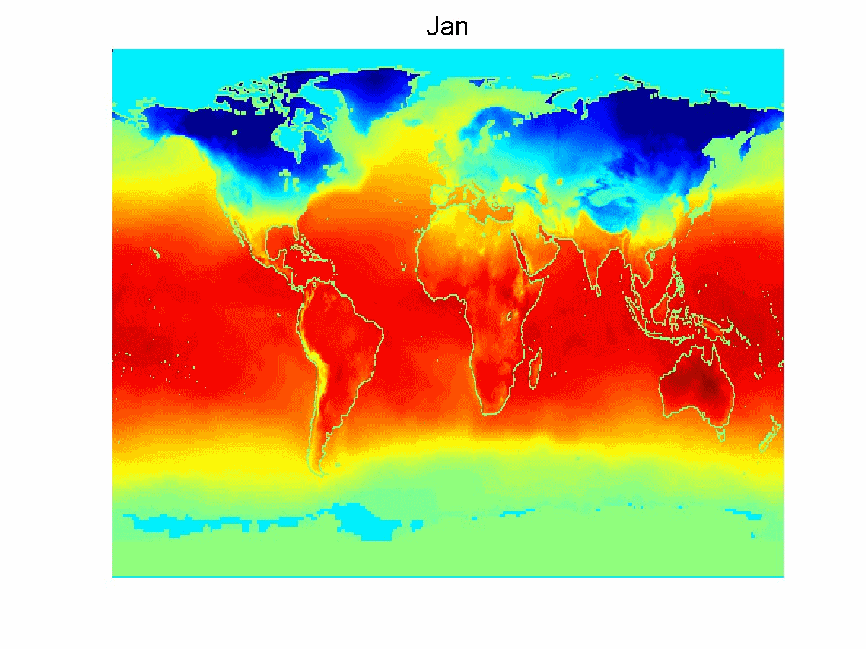
Temporal Data
Average Monthly Temperature of land and ocean

Slide 24
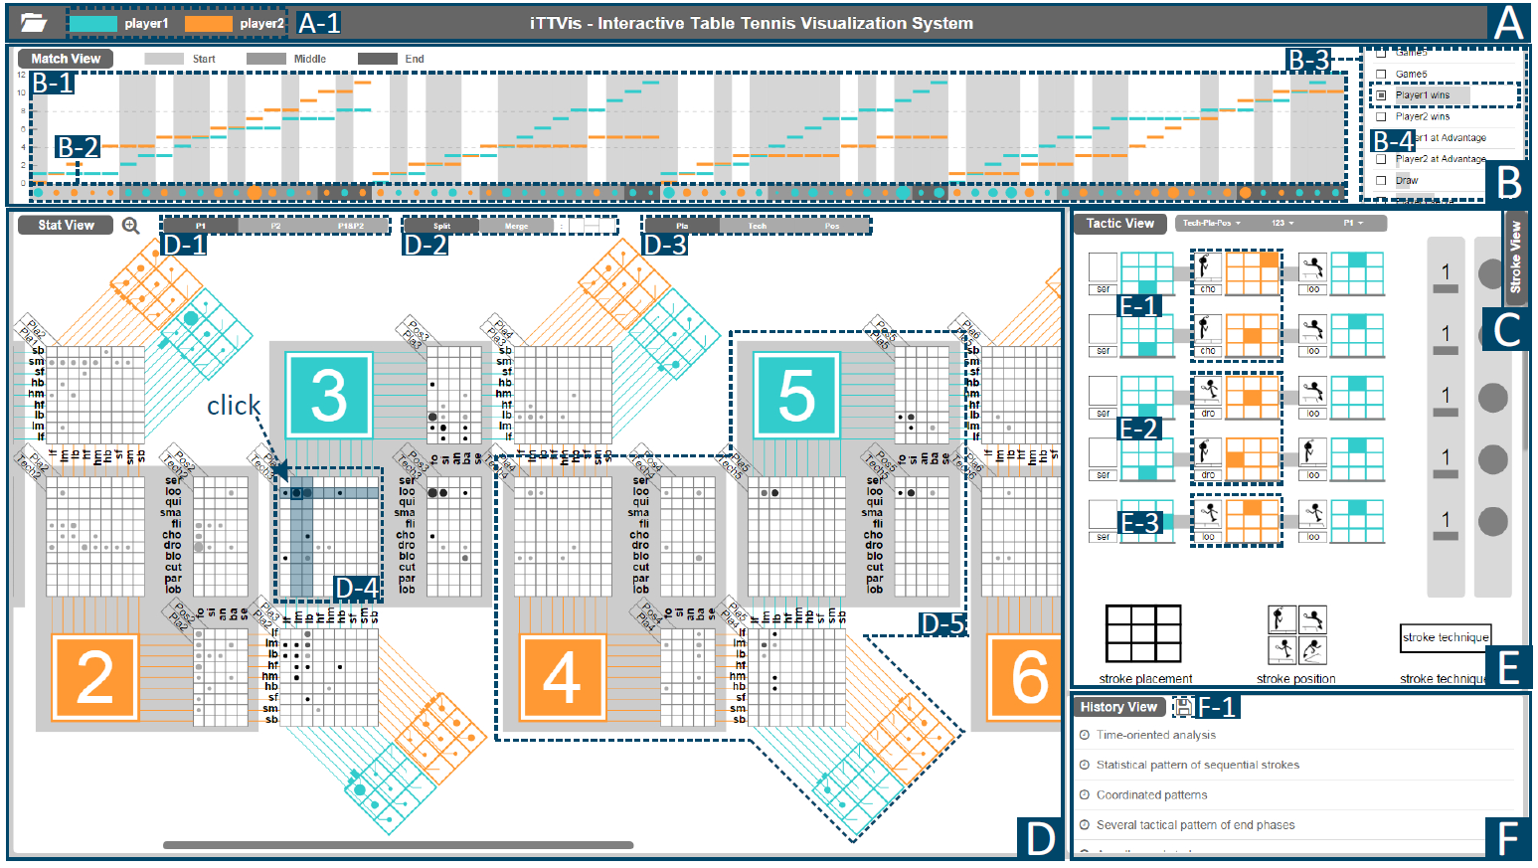

Slide 25





Slide 26
Outline
Data: attributes and objects
Types of Data
Data Quality
Data Preprocessing
Similarity and Distance

Slide 27
Data Quality
Poor data quality negatively affects many data processing efforts
“The most important point is that poor data quality is an unfolding disaster.
Poor data quality costs the typical company at least ten percent (10%) of revenue; twenty percent (20%) is probably a better estimate.”
Thomas C. Redman, DM Review, August 2004
Data mining example: a classification model for detecting people who are loan risks is built using poor data
Some credit-worthy candidates are denied loans
More loans are given to individuals that default

Slide 28
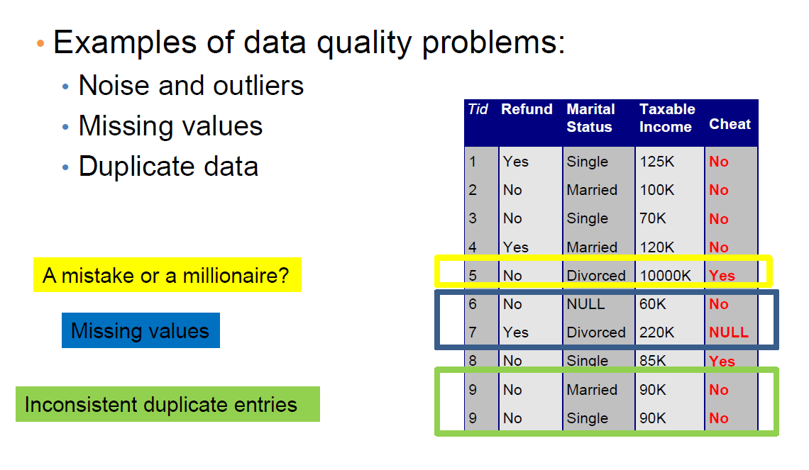
Data Quality
Notes:
What kinds of data quality problems?
How can we detect problems with the data?
What can we do about these problems

Slide 29
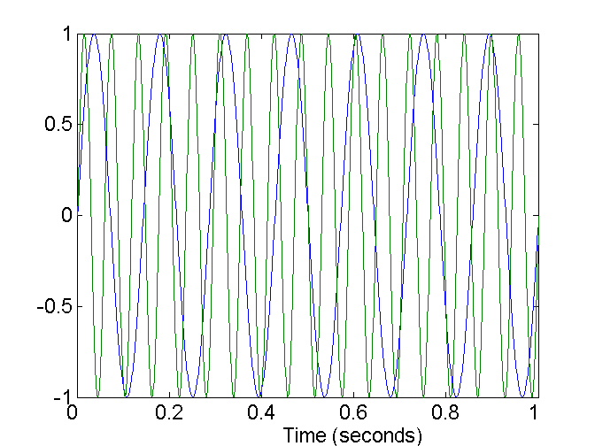
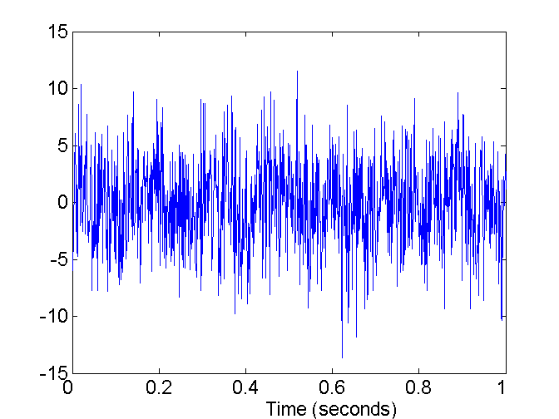
Noise
For objects, noise is an extraneous object
For attributes, noise refers to modification of original values
Examples: distortion of a person’s voice when talking on a poor phone and “snow” on television screen
Two Sine Waves
Two Sine Waves + Noise

Slide 30

Outliers
Outliers are data objects with characteristics that are considerably different than most of the other data objects in the data set
Case 1: Outliers are noise that interferes with data analysis
Case 2: Outliers are the goal of our analysis
Credit card fraud
Intrusion detection

Slide 31
Missing Values
Reasons for missing values
Information is not collected (e.g., people decline to give their age and weight)
Attributes may not be applicable to all cases (e.g., annual income is not applicable to children)
Handling missing values
Eliminate data objects or variables
Estimate missing values
Example: time series of temperature
Example: census results
Ignore the missing value during analysis

Slide 32
Duplicate Values
Data set may include data objects that are duplicates, or almost duplicates of one another
Major issue when merging data from heterogeneous sources
Data cleaning
Process of dealing with duplicate data issues
When should duplicate data not be removed?
Examples:
Same person with multiple email addresses

Slide 33
Outline
Data: attributes and objects
Types of Data
Data Quality
Data Preprocessing
Similarity and Distance

Slide 34
Data Preprocessing
Data Transformation: smoothing, normalization…
Data Reduction: sampling, dimensionality reduction, aggregation

Slide 35
Data Transformation
Smoothing: remove noise from data
Normalization: scaled to fall within a small, specified range

Slide 36
Data Transformation: Normalization
min-max normalization
z-score normalization
normalization by decimal scaling
Where j is the smallest integer such that Max(| |)<1
Notes:
z-score标准化方法适用于属性A的最大值和最小值未知的情况，或有超出取值范围的离群数据的情况。该种标准化方式要求原始数据的分布可以近似为高斯分布，否则效果会变得很糟糕。

Slide 37
Data Reduction
Data is too big to work with
Data reduction
Obtain a reduced representation of the data set that is much smaller in volume but yet produce the same (or almost the same) analytical results
Data reduction strategies
Sampling
Dimensionality reduction — remove unimportant attributes
Aggregation and clustering

Slide 38
Sampling
Sampling is the main technique employed for data reduction.
It is often used for both the preliminary investigation of the data and the final data analysis.
Statisticians often sample because obtaining the entire set of data of interest is too expensive or time consuming.
Sampling is typically used in data mining because processing the entire set of data of interest is too expensive or time consuming.

Slide 39
Sampling
The key principle for effective sampling is the following:
Using a sample will work almost as well as using the entire data set, if the sample is representative
A sample is representative if it has approximately the same properties (of interest) as the original set of data

Slide 40

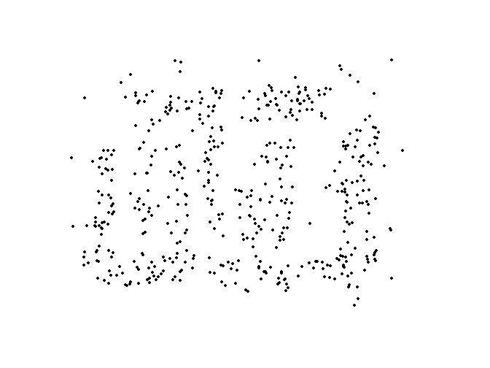
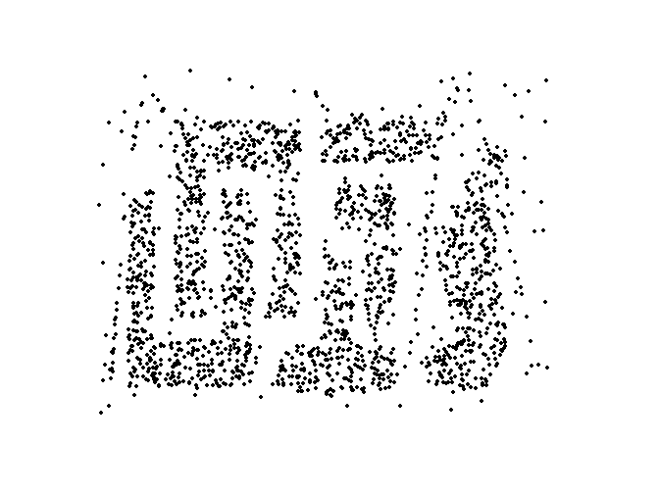
Types of Sampling
Simple Random Sampling
There is an equal probability of selecting any particular item
Sampling without replacement
As each item is selected, it is removed from the population
Sampling with replacement
Objects are not removed from the population as they are selected for the sample.
In sampling with replacement, the same object can be picked up more than once
8000 points 2000 Points 500 Points

Slide 41
Types of Sampling
Stratified sampling
Split the data into several partitions; then draw random samples from each partition
Raw Data
Cluster/Stratified Sample

Slide 42
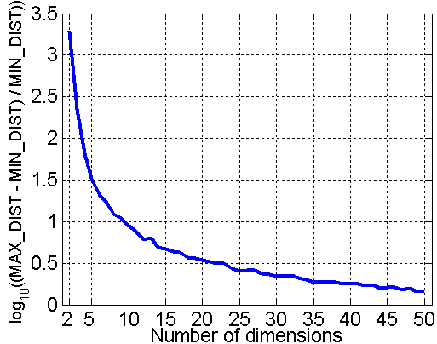
Curse of Dimensionality
When dimensionality increases, data becomes increasingly sparse in the space that it occupies
Definitions of density and distance between points, which are critical for clustering and outlier detection, become less meaningful
Randomly generate 500 points
Compute difference between max and min distance between any pair of points

Slide 43
Dimensionality Reduction
Feature selection :
Select a minimum set of attributes (features) that is sufficient for the data mining task.
Techniques
Principal Components Analysis (PCA)
Singular Value Decomposition
Others: supervised and non-linear techniques

Slide 44
Dimensionality Reduction: PCA
Goal is to find a projection that captures the largest amount of variation in data
x₂
e
x₁
Principle Component Analysis
Notes:
将坐标轴中心移到数据的中心，然后旋转坐标轴，使得数据在C1轴上的上的方差最大，即全部n个数据个体在该方向上的投影最为分散。意味着更多的信息被保留下来。C1成为第一主成分。
C2第二主成分：找一个C2，使得C2与C1的协方差（相关系数）为0，以免与C1信息重叠，并且使数据在该方向的方差尽量最大。

Slide 45
Dimensionality Reduction：Feature Creation
Create new attributes that can capture the important information in a data set much more efficiently than the original attributes
Three general methodologies:
Feature extraction
Example: extracting edges from images
Feature construction
Example: dividing mass by volume to get density
Mapping data to new space
Example: Fourier and wavelet analysis

Slide 46
Outline
Data: attributes and objects
Types of Data
Data Quality
Data Preprocessing
Similarity and Distance

Slide 47
Similarity & Dissimilarity Measures
Similarity measure
Numerical measure of how alike two data objects are.
Is higher when objects are more alike.
Often falls in the range [0,1]
Dissimilarity measure
Numerical measure of how different two data objects are
Lower when objects are more alike
Minimum dissimilarity is often 0
Upper limit varies
Proximity refers to a similarity or dissimilarity

Slide 48
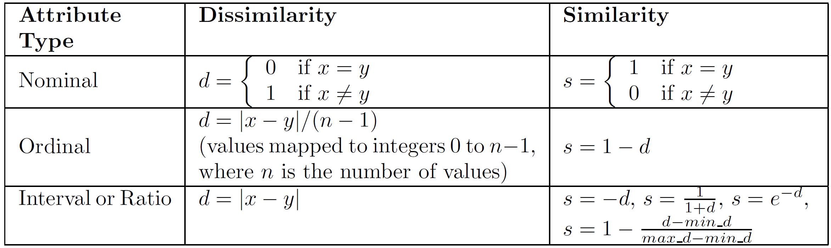
Similarity & Dissimilarity Distance
The following table shows the similarity and dissimilarity between two objects, x and y, with respect to a single, simple attribute.

Slide 49
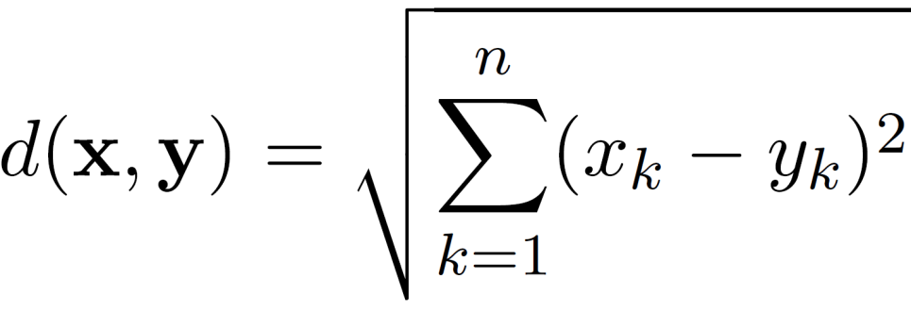
Euclidean Distance
Euclidean Distance
where n is the number of dimensions (attributes) and x_{k} and y_{k} are, respectively, the k^{th} attributes (components) or data objects x and y.
Standardization is necessary, if scales differ.

Slide 50
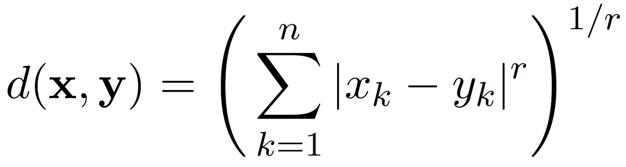
Minkowski Distance
Minkowski Distance is a generalization of Euclidean Distance
Where r is a parameter, n is the number of dimensions (attributes) and x_{k} and y_{k} are, respectively, the k^{th} attributes (components) or data objects x and y.

Slide 51
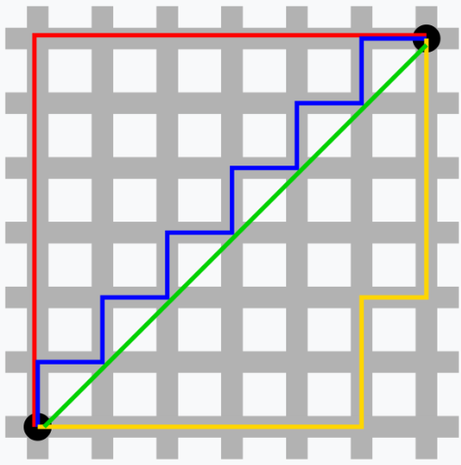
Minkowski Distance
r = 1. City block (Manhattan, taxicab, L₁ norm) distance.
r = 2. Euclidean distance
r → ∞. “supremum” (L_{max} norm, L∞ norm) distance.
This is the maximum difference between any component of the vectors
Do not confuse r with n, i.e., all these distances are defined for all numbers of dimensions.
Notes:
切比雪夫距离
距离计算比较直观，当两个维度尺度差异较大时，就会过度放大某个维度的作用。因此在使用这些距离时，最好是先对数据进行标准化处理

Slide 52
已知：
小明（160cm, 60000g）
小王（160cm, 59000g）
小李（170cm, 60000g）
根据身高体重的信息来判断体型的相似程度

Slide 53
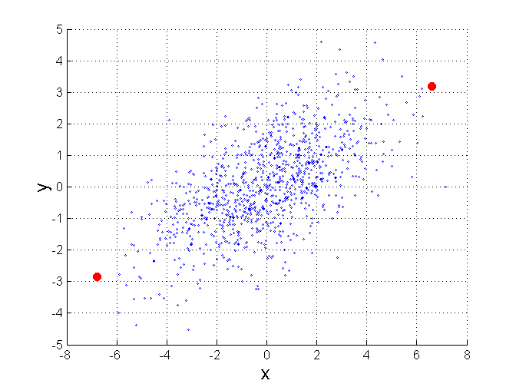
Mahalanobis Distance
$$mahalanobis\left(x,y\right)={ (x−y)}^{T}Ʃ^{−1}(x−y)$$
Σ is the covariance matrix
For red points, the Euclidean distance is 14.7, Mahalanobis distance is 6.

Slide 54
Cosine Similarity
If d₁ and d₂ are two document vectors, then
cos( d₁, d₂ ) = <d₁,d₂> / ||d₁|| ||d₂|| ,
where <d₁,d₂> indicates inner product or vector dot product of vectors, d₁ and d_{2,} and || d || is the length of vector d.
Example:
句子A：我喜欢游泳，不喜欢画画。
句子B：我不喜欢游泳，也不喜欢画画。
我 喜欢 游泳 不 画画 也
d₁ = 1 2 1 1 1 0
d₂ = 1 2 1 2 1 1
cos( d₁, d₂ ) = 0.9186
思考：
如何在距离计算中结合语义信息？

Slide 55
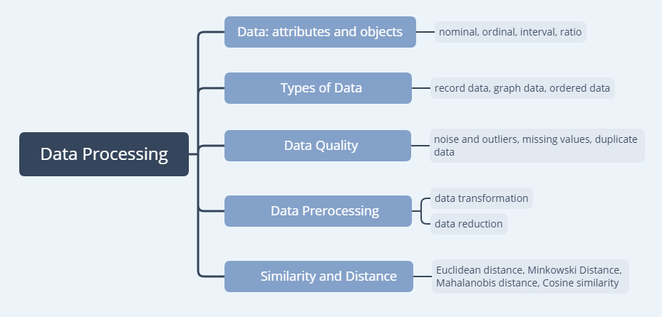
Take Home Message
Data is a significant aspect to explore
for proposing innovation idea.

Slide 56
Thank You!

